Slide 1

Exploring One-Cell Inversion Method for Transient Transport on GPUs
Joanna Piper Morgan, Ilham Variansyah, Todd S. Palmer, & Kyle E. Niemeyer
The Center for Exascale Monte Carlo Neutron Transport (CEMeNT) at Oregon State University
Time-Dependent and Radiative Transfer Methods at
The International Conference on Mathematics and Computational Methods Applied to Nuclear Science & Engineering
Niagara Falls, Ontario, Canada
Wednesday, August 15th, 2023
cement-psaap.github.io

Slide 2
Code github.com/CEMeNT-PSAAP/Therefore
Center cement-psaap.github.io

Slide 3
THE
EXASCALE

Slide 4
GPU Computations
Single Instruction Multiple Thread (SIMT)
Beat communication v work paradigm
Un-divergent algorithms with local data
Ideally some kind of abstraction (compiler toolchains?)

Slide 5
Recap: Transient Deterministic Transport
Transport sweeps aka source Iterations aka Richardson iterations [1]
K-B-A Algorithms above 1D [2]
Preconditioners &/or synthetic accelerators
Many many many bells and whistles
Partisan (LANL), Ardra (LLNL), Denovo (ORNL) Etc.

Slide 6
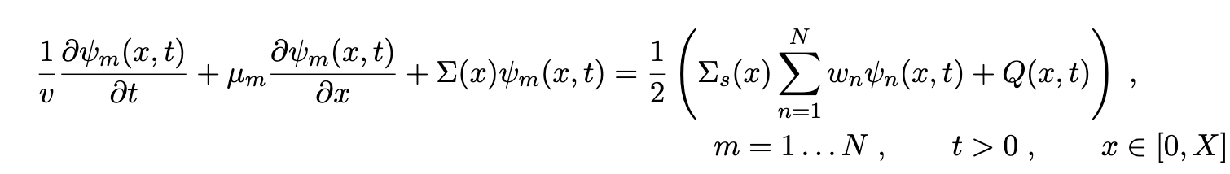
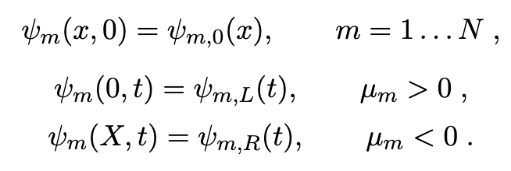
Neutron Transport
kinda
World’s simplest problem…
Assumptions:
Slab wall geometry
Axi-symmetric
Isotropic source and scattering
G-L quadrature
Monoenergetic
NOT Steady State!!!!

Slide 7
Iterative Methods
Intrgro-PDE requires some kind of iterative method
Very large phase space
We want to go fast ∴ parallelize & hardware accelerate
N_{angle} << N_{cell}
N = 4*N_{time}* N_{angle}*N_{cell}

Slide 8

source iteration
Initialize φ_{g}
known * ψ_{m,i,k}^{(l)} + known * ψ_{m,i±1,k}^{(l)} =
known
compute rhs
φ_{n} becomes φ_{g}
and φ_{n}
aka Ax=b
solve for ψ
solve lhs (sweep)
nope
1
2
3
4
5
compute φ_{n}
convergence
angles
yup
done!
cells

Slide 9
one cell inversion
Initialize Ψ_{g}
known
known * ψ_{m,i,k}^{(l)} + known * ψ_{m,i±1,k}^{(l-1)} = known
communicate cellwise bound info
Ψ_{n} becomes ψ_{g}
aka Ax=b
solve for ψ
nope
1
2
3
4
5
solve for all Ψ_{n}
convergence?
angles
yup
[3] & [4]
done!
cells

Slide 10
SI communicates information between cells within an ordinate WITHIN an iteration
OCI communicates information between cells only BETWEEN iterations

Slide 11
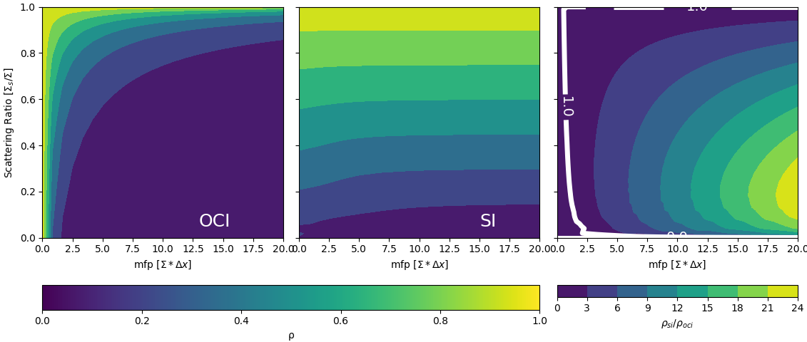
spectral radius

Slide 12
Benefits of OCI on the GPU
Parallelizing over the normally dominant dimension
Lots of independent more complex linear algebra
Information is local within an iteration
No K-B-A required in higher dimensions!

Slide 13
The Hunch
While one cell inversions will require more iterations to converge some solutions
Those iterations will be faster when done on the GPU due to decreased thread divergence and parallelization over the dominant dimension (space)
Leading to decreased wall-clock runtime when space is the dominant dimension

Slide 14
Higher Order Discretization
Time: Time dependent multiple balance [5]
Space: Simple Corner Balance [6]
By coupling two second order schemes we can improve the work v communication paradigm on GPUs
Fourier analysis shows this scheme is second order
Scheme can produce negative fluxes

Slide 15
Verification Problems
Source free homogeneous pure absorber
Infinite homogeneous medium
AZURV1
MC/DC

Slide 16
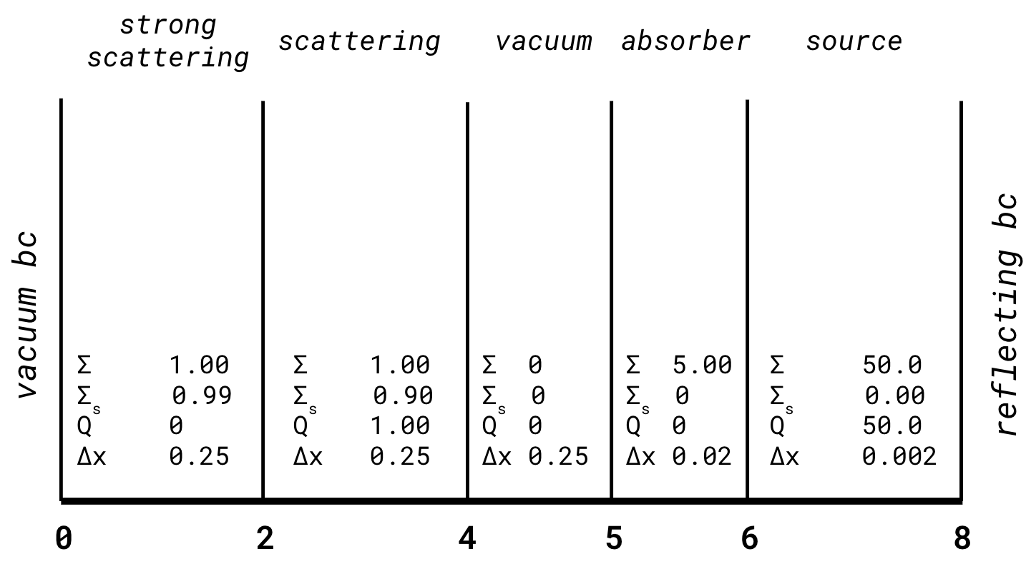
Transient Reed’s-esq problem
Initial Condition zero everywhere

Slide 17
Transient Reed’s-esq problem
Δt = 1s
N_{time} = 5
v = 4cm/s
S₆₄
Wall clock runtime:
OCI 17.01
SI 33.76
2.0X speedup!!!

Slide 18
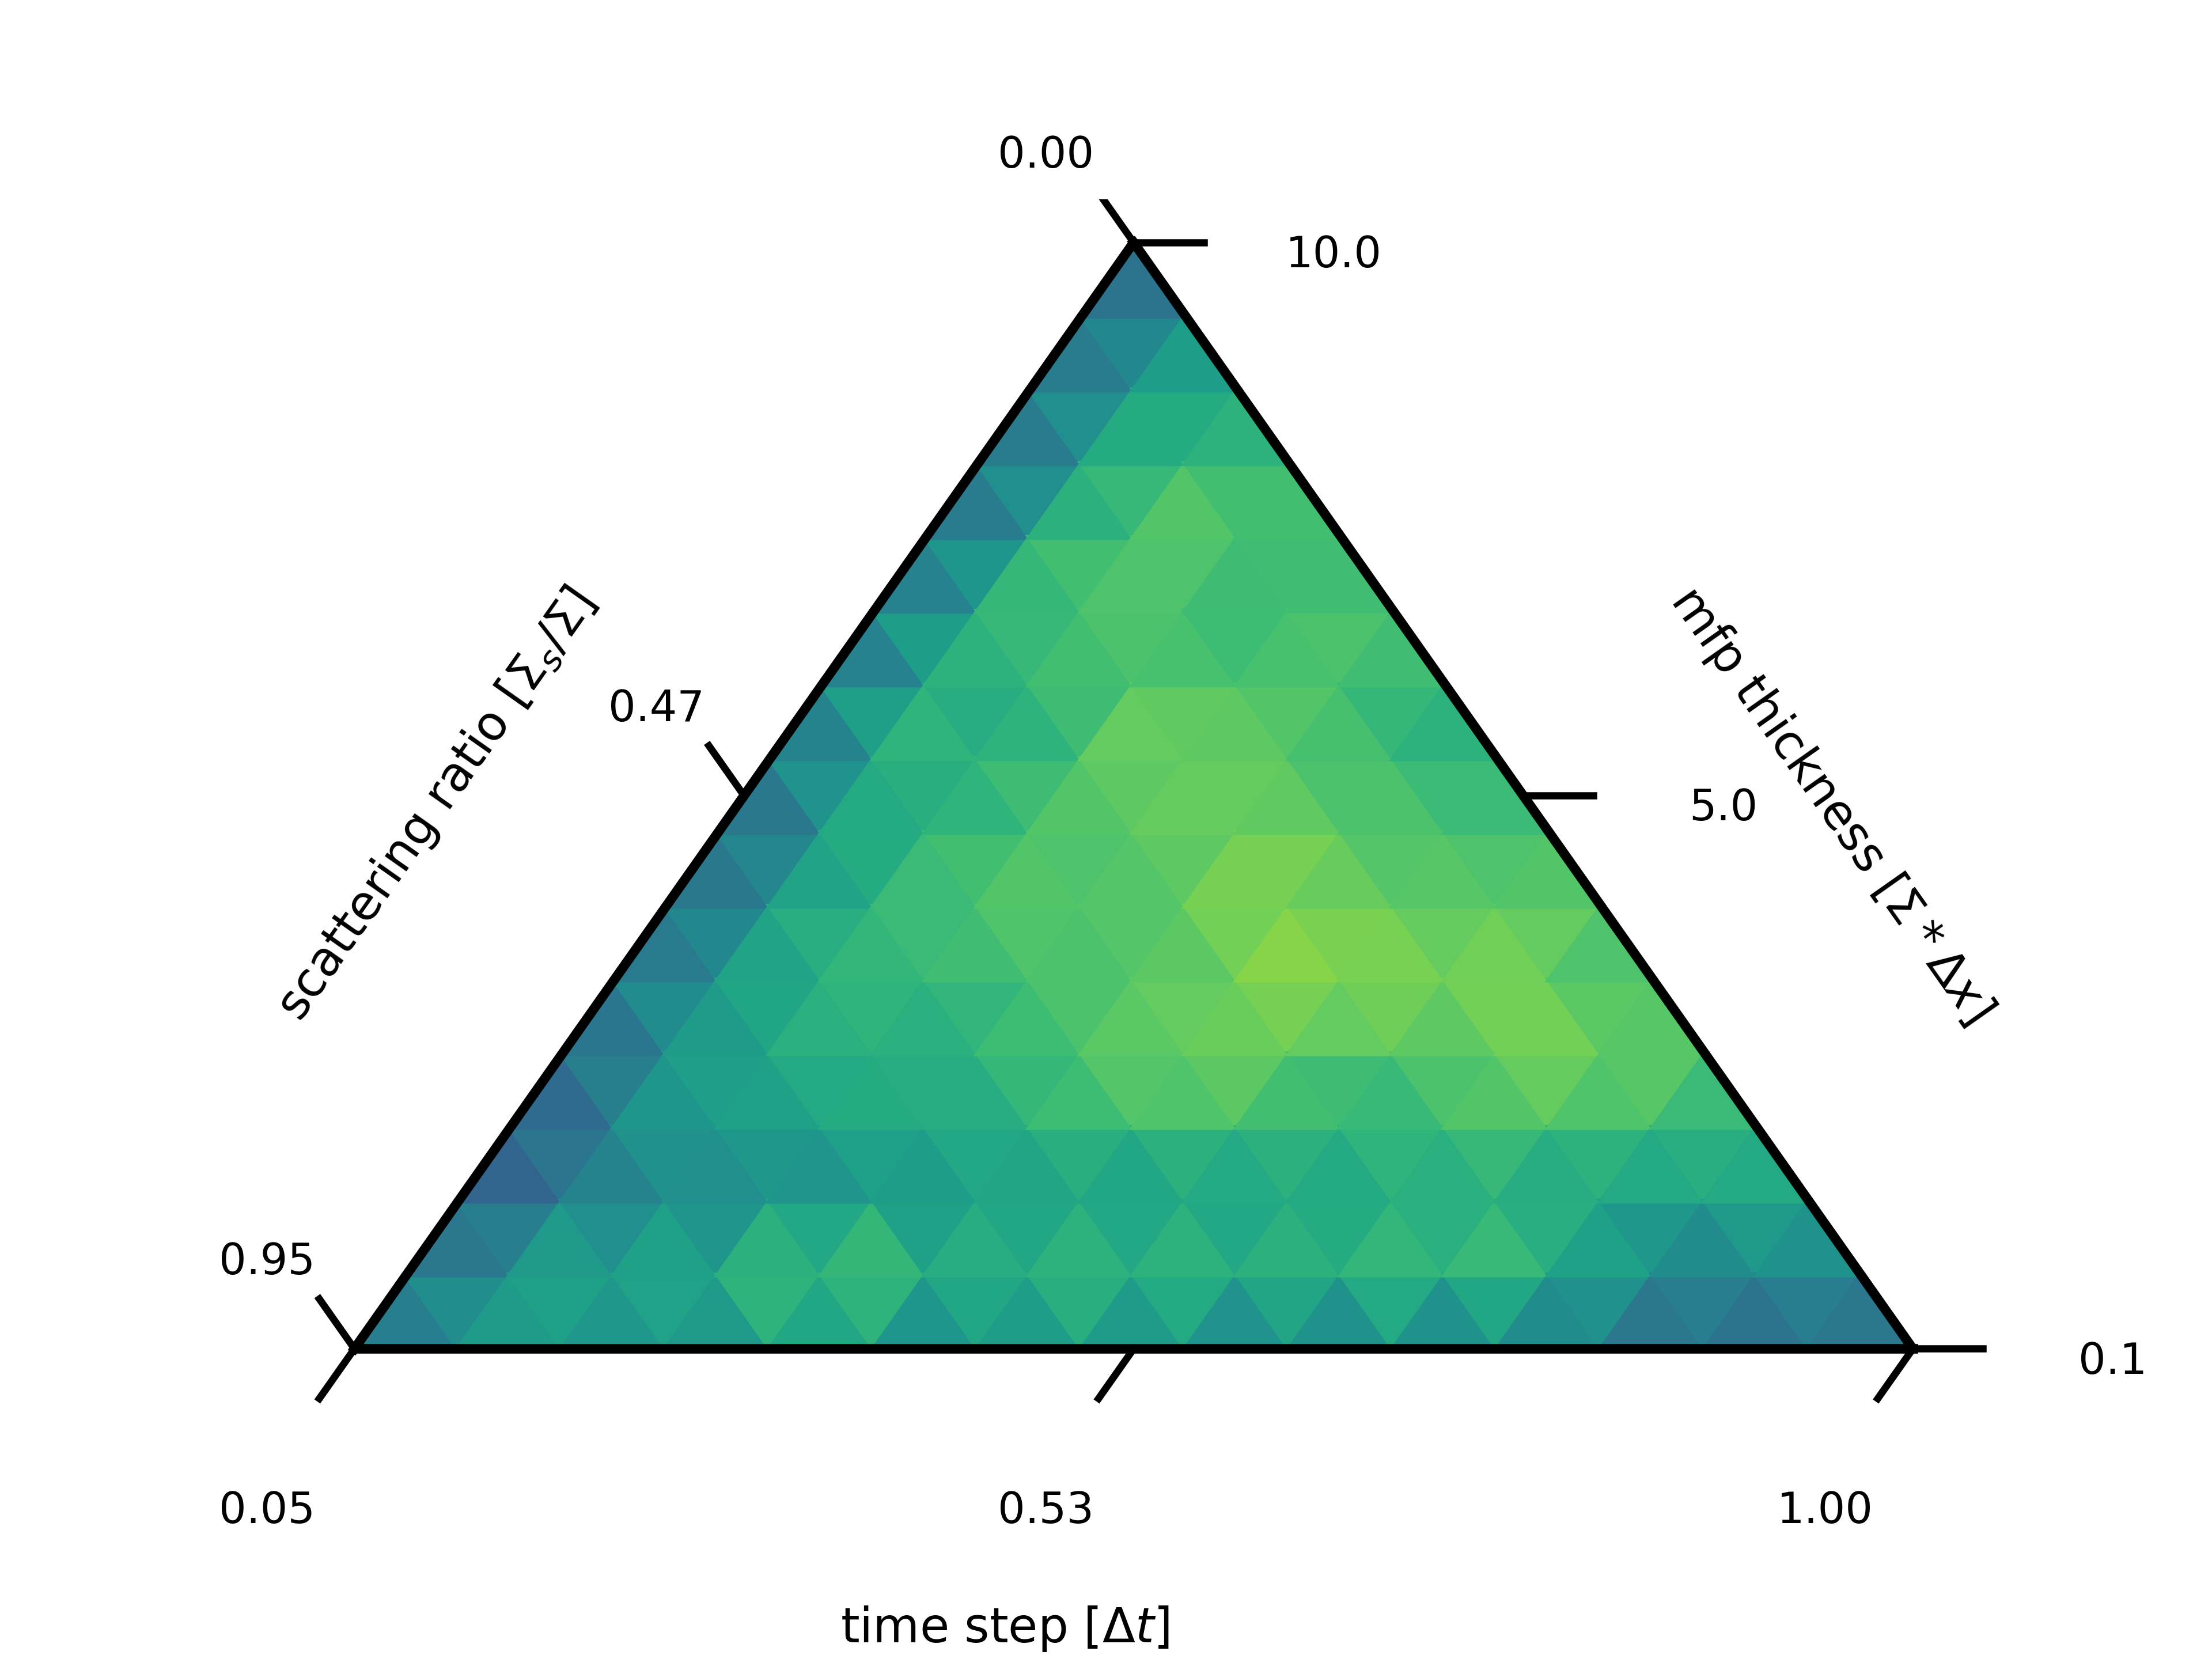
Performance Comparisons
Convergence behavior is governed by:
Scattering ratio
Δt
Quadrature order
Cell thickness in mean-free-paths
vac
vac
Varied Parameters
Δx
Δt
Σ_{s}
N_{angles}
v = 4 cm/s
Q = 0.1 s⁻¹cm⁻³
Σ =2 cm⁻¹
10cm

Slide 19

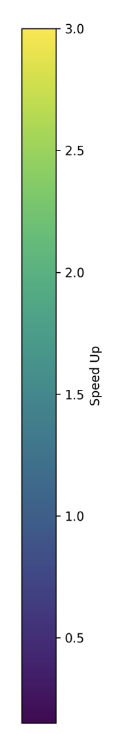
S₄

Slide 20
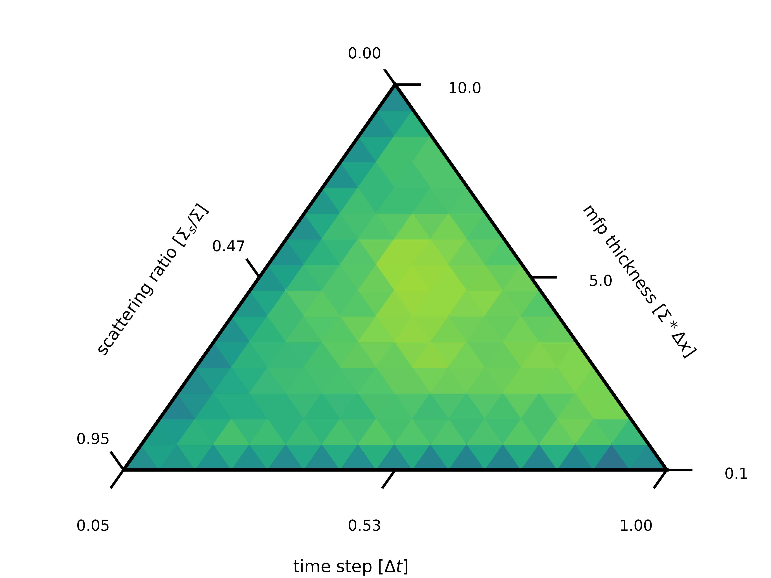
S₁₆

Slide 21
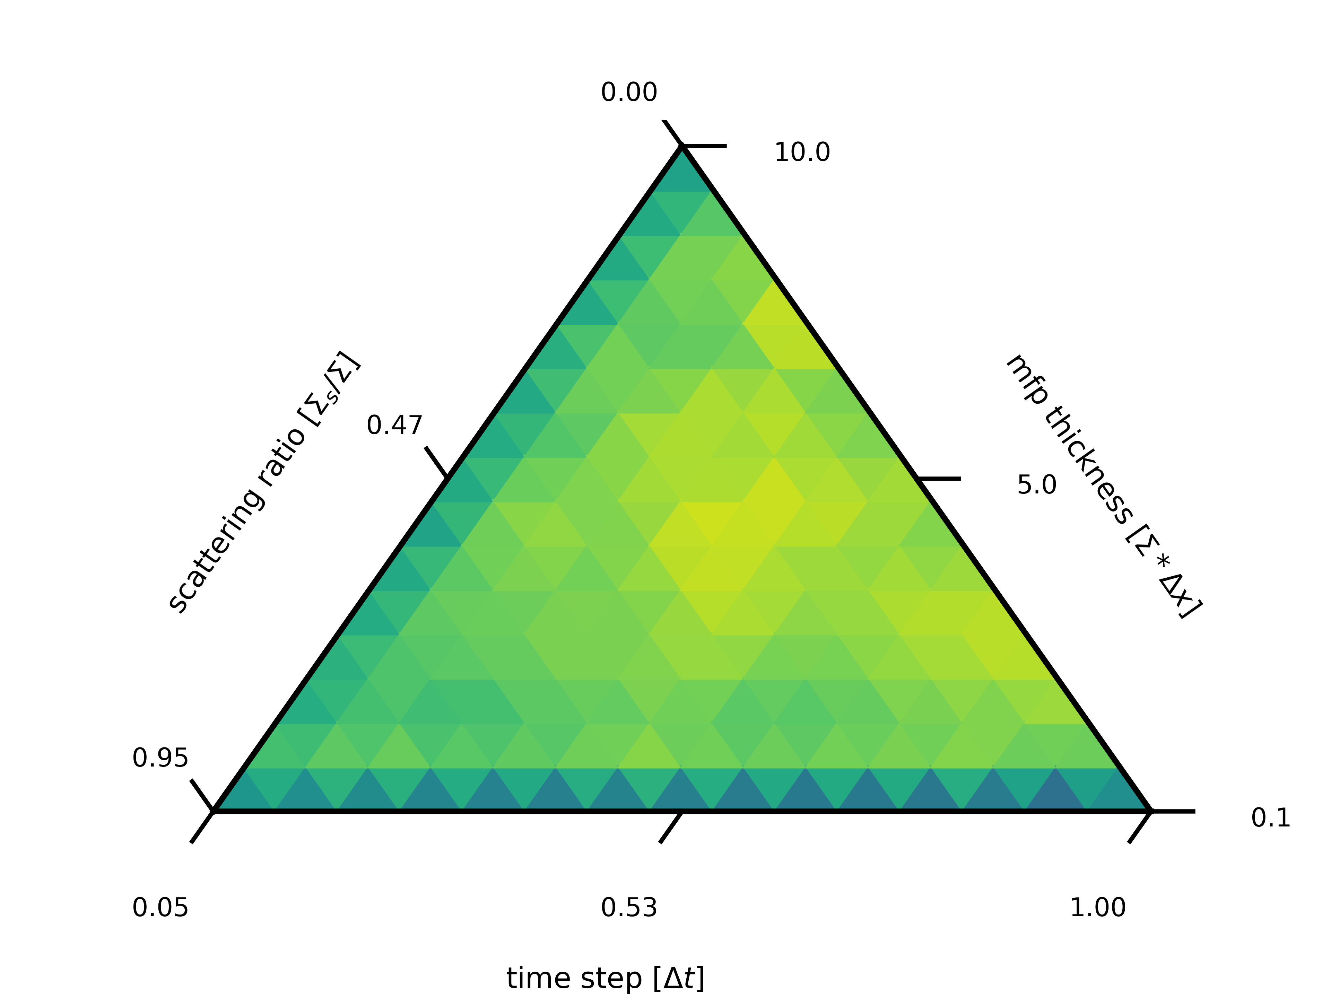
S₃₂

Slide 22
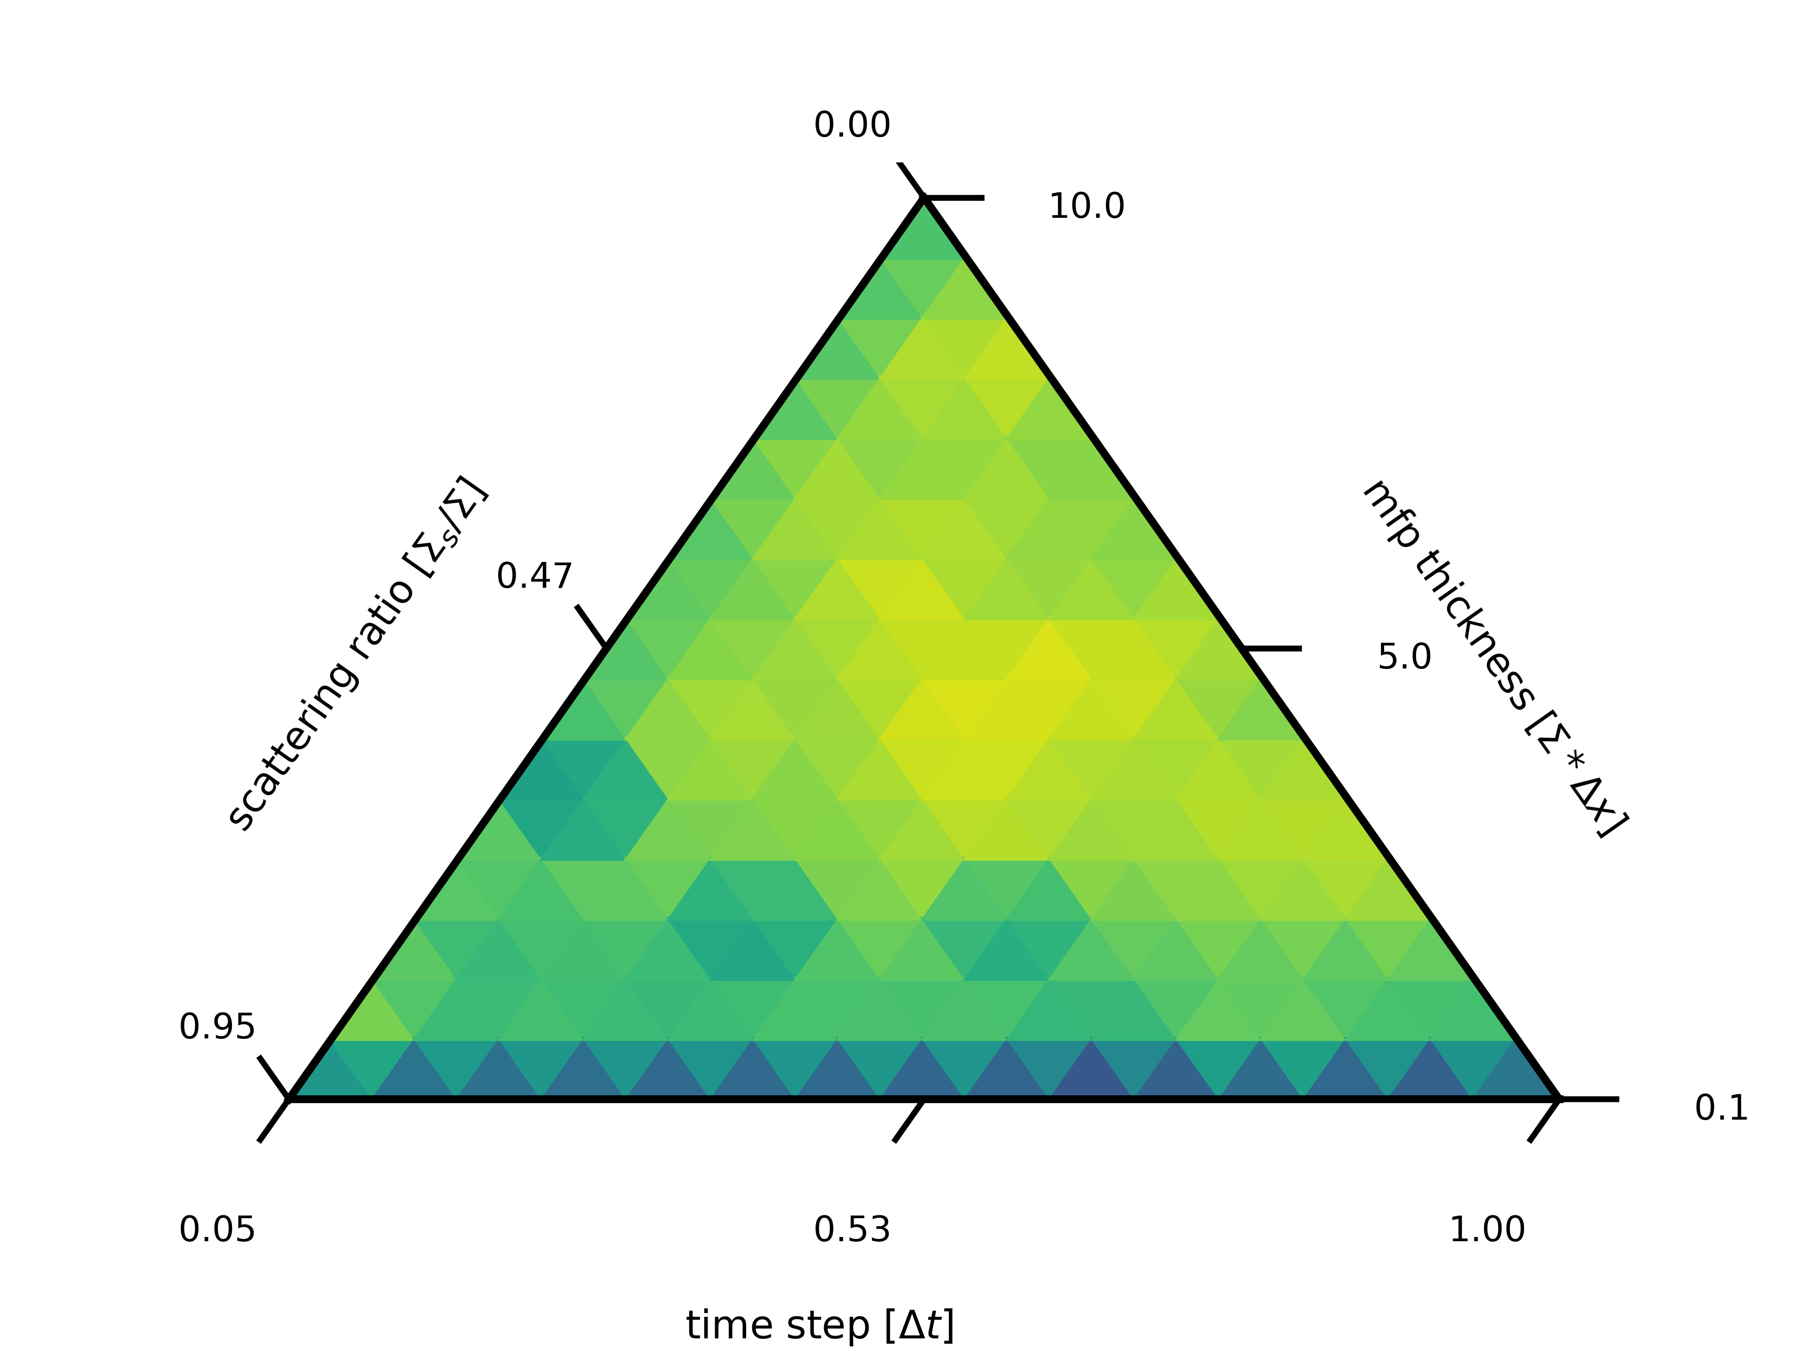
S₆₄

Slide 23
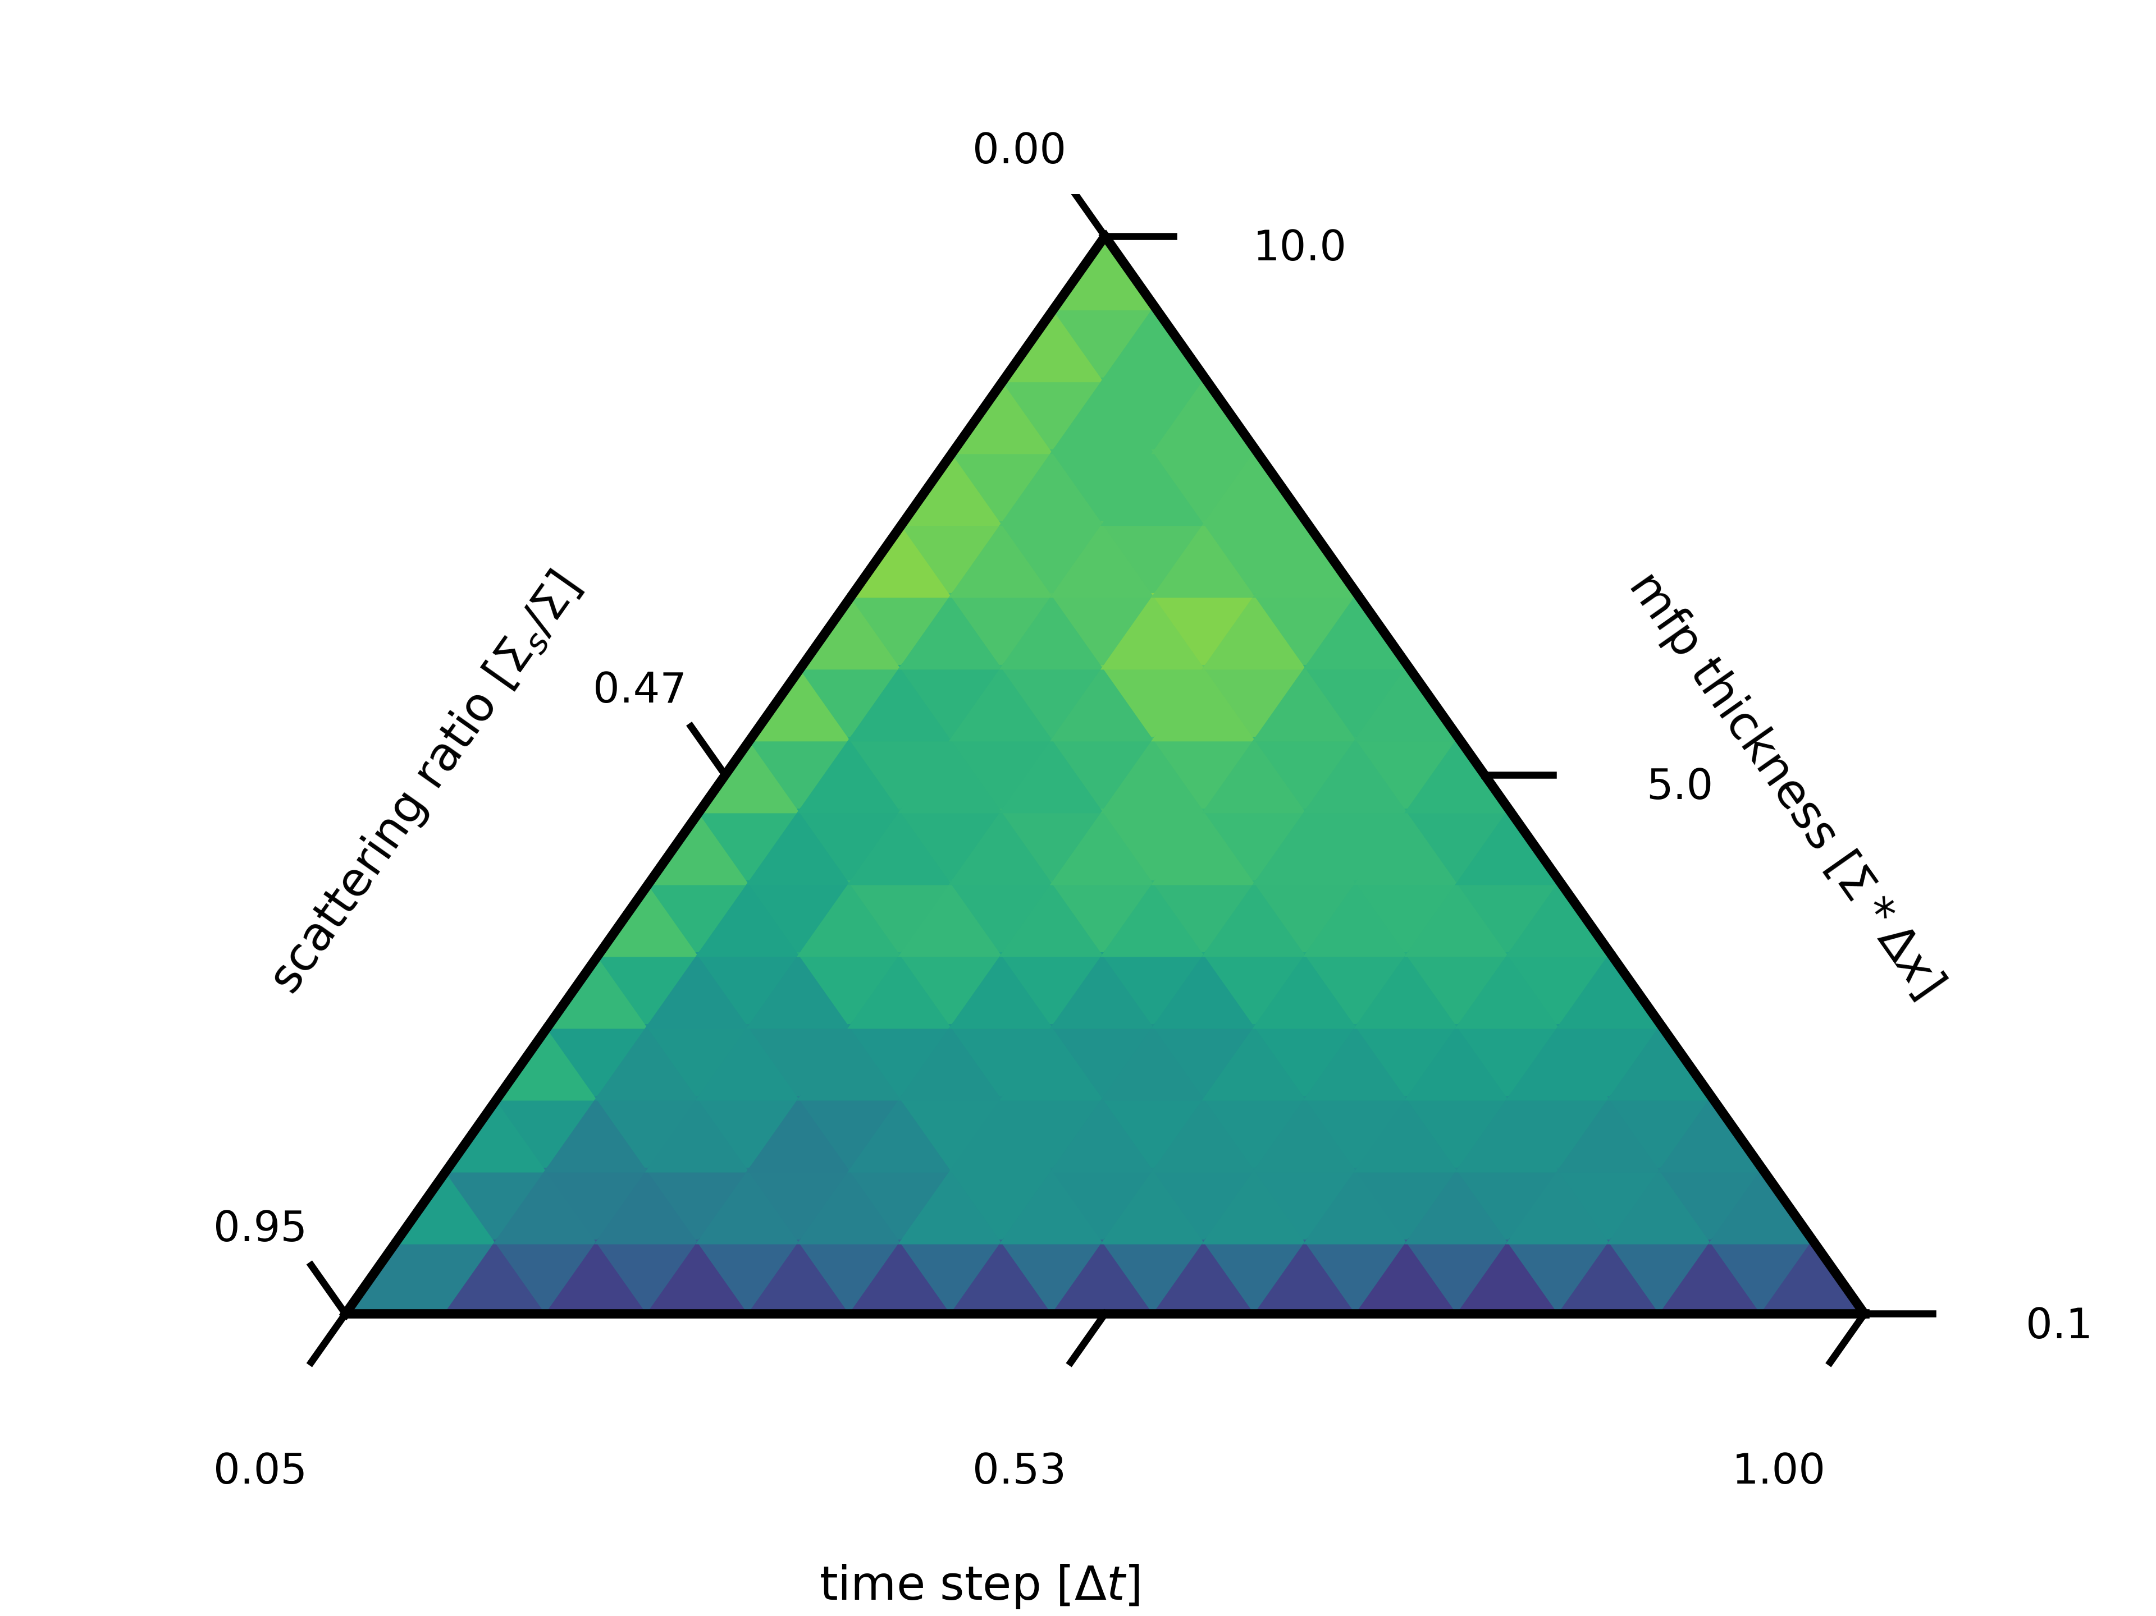
S₁₂₈

Slide 24
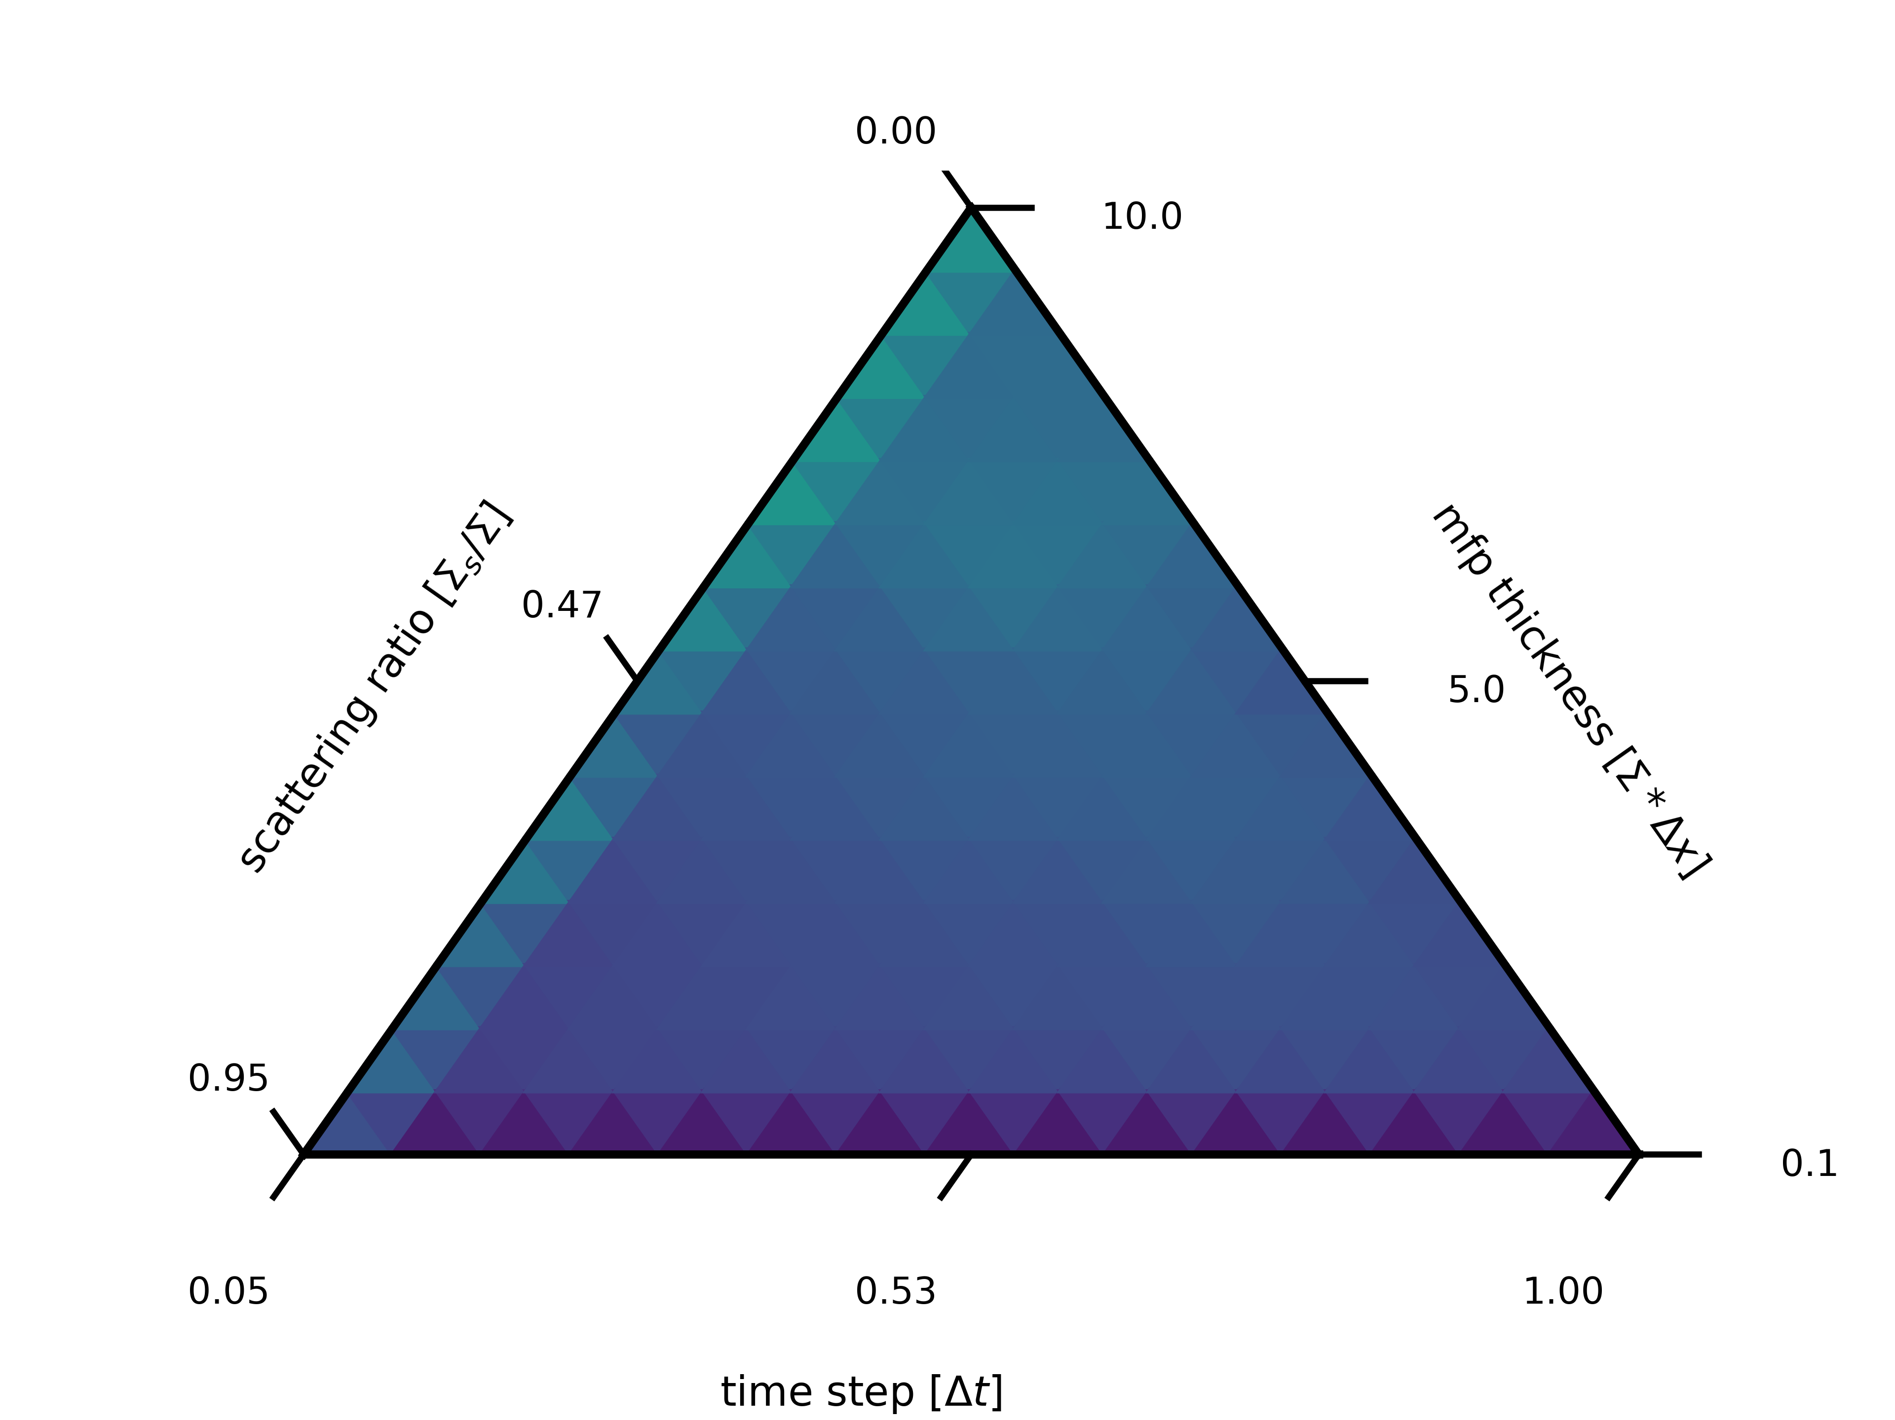
S₂₅₆

Slide 25
Analysis
We overcome communication v work paradigm for GPUs around S₁₆
OCI seems to outperform SI thru S₆₄
As angular quadrature becomes the dominant parallelizable dimension, SI moves wins out, with no speed up found by S₂₅₆

Slide 26
Conclusions
OCI outperforms SI in parallel performance when there are many many more cells then angles on GPUs
OCI still underperforms in unfavorable problem regimes (i.e., highly scattering)

Slide 27
Future Work
Explorations with preconditioners and/or synthetic acceleration
Energy dependence, converging all groups at the same time
Explorations of exascale hardware (large memory bus between GPU and CPU)
Performance comparison of developer toolchains across hardware

Slide 28
Acknowledgments
This work was supported by the Center for Exascale Monte-Carlo Neutron Transport (CEMeNT) a PSAAP-III project funded by the Department of Energy, grant number: DE-NA003967.

Slide 29
Questions

Slide 30
Citations
[1] M. L. Adams and E. W. Larsen. “Fast iterative methods for discrete-ordinates particle transport calculations.” Progress in nuclear energy, 40(1), pp. 3–159 (2002).
[2] R. S. Baker. “An SN Algorithm for Modern Architectures.” Nuclear science and engineering, 185(1), pp. 107–116 (2017)
[3] D. Anistratov and Y. Y. Azmy. “Iterative stability analysis of spatial domain decomposition based on block Jacobi algorithm for the diamond-difference scheme.” Journal of Computational Physics, 297(C), pp. 462–479 (2015).
[4] D. S. Hoagland and Y. Y. Azmy. “Hybrid approaches for accelerated convergence of block-Jacobi iterative methods for solution of the neutron transport equation.” Journal of Computational Physics, 439(2021). URL https://www.osti.gov/biblio/1815296.
[5] I. Variansyah, E. W. Larsen, and W. Martin. “A Robust Second-Order Multiple Balance Method for Time-Dependent Neutron Transport Simulations.” The European Physical Journal Conferences, 247, p. 03024 (2021).
[6] M. L. Adams. “Subcell balance methods for radiative transfer on arbitrary grids.” Transport Theory and Statistical Physics, 26(4-5), pp. 385–431 (1997). URL https://doi.org/10.1080/00411459708017924

Slide 31
Backmatter

